Slide 1
GIT

Slide 2
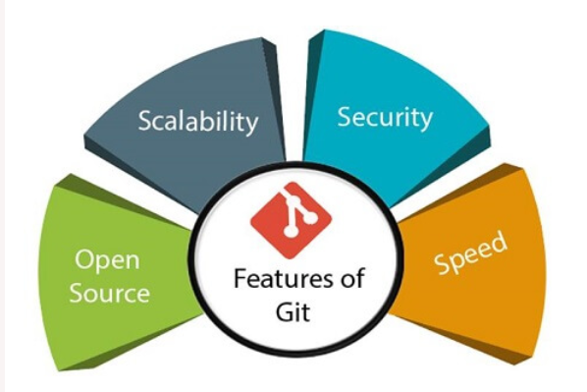
What is git
Git is an open-source distributed version control system. It is designed to handle minor to major projects with high speed and efficiency. It is developed to co-ordinate the work among the developers. The version control allows us to track and work together with our team members at the same workspace.

Slide 3
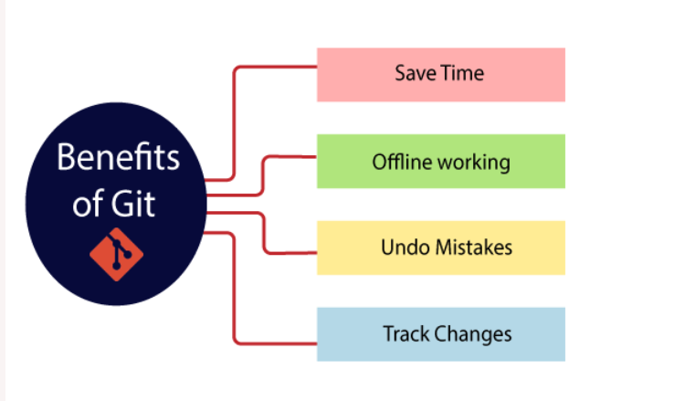
Benefits of git

Slide 4
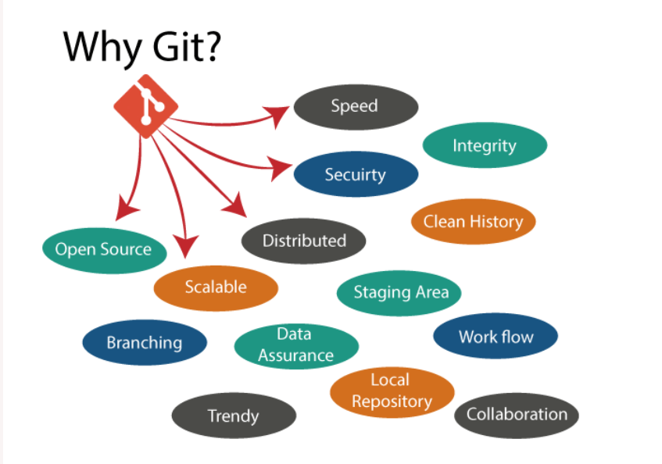
Why git

Slide 5
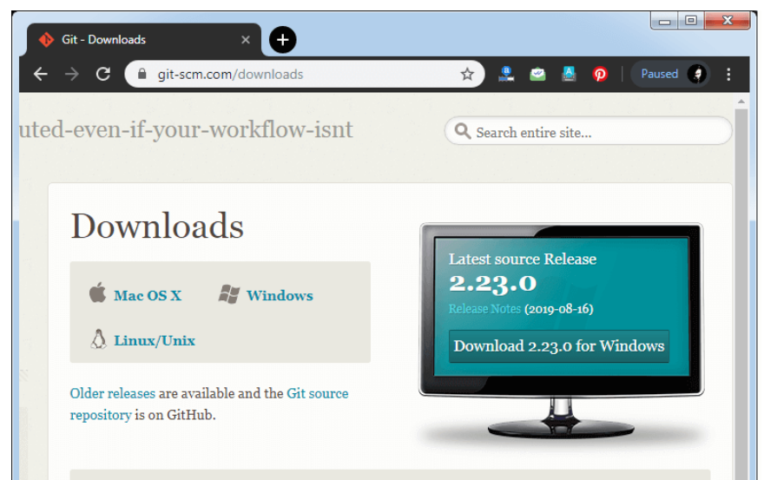
Install git on windows
Step1
To download the Git installer, visit the Git's official site and go to download page. The link for the download page is https://git-scm.com/downloads. The page looks like as

Slide 6
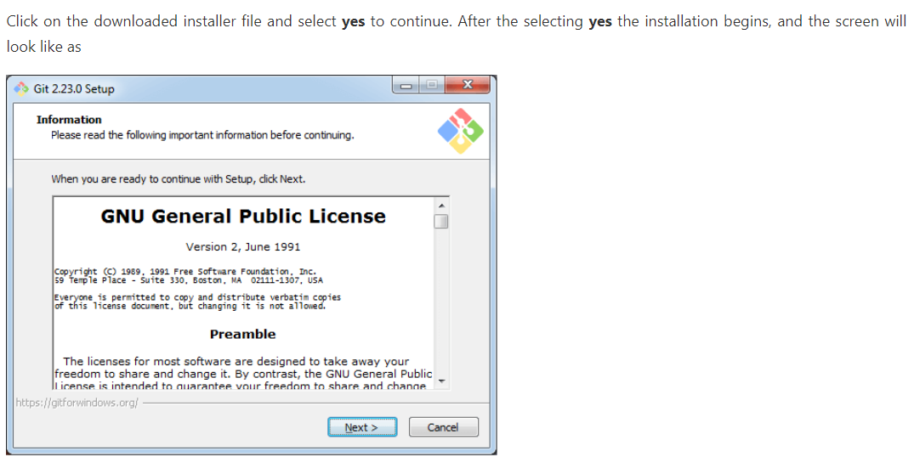
Git installation steps

Slide 7
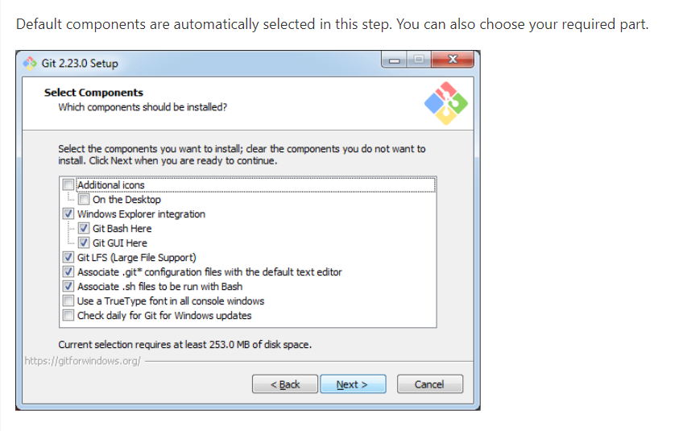
Git installation steps

Slide 8
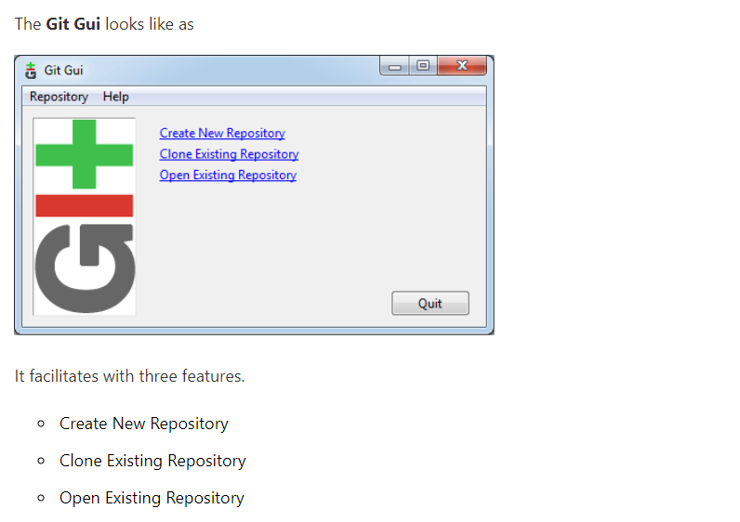
Git installation steps

Slide 9
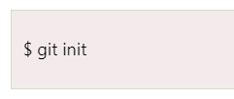
Git init
The git init command is the first command that you will run on Git. The git init command is used to create a new blank repository. It is used to make an existing project as a Git project. Several Git commands run inside the repository, but init command can be run outside of the repository.
The git init command creates a .git subdirectory in the current working directory. This newly created subdirectory contains all of the necessary metadata. These metadata can be categorized into objects, refs, and temp files. It also initializes a HEAD pointer for the master branch of the repository.

Slide 10

Git status
The git status command is used to display the state of the repository and staging area. It allows us to see the tracked, untracked files and changes. This command will not show any commit records or information.
Mostly, it is used to display the state between Git Add and Git commit command. We can check whether the changes and files are tracked or not.

Slide 11

Git add
The git add command is used to add file contents to the Index (Staging Area).This command updates the current content of the working tree to the staging area. It also prepares the staged content for the next commit. Every time we add or update any file in our project, it is required to forward updates to the staging area.
The git add command is a core part of Git technology. It typically adds one file at a time, but there some options are available that can add more than one file at once.

Slide 12
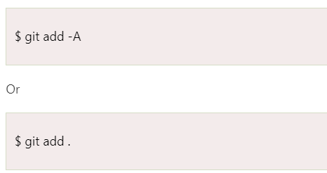
Git add all
We can add more than one files in Git, but we have to run the add command repeatedly. Git facilitates us with a unique option of the add command by which we can add all the available files at once. To add all the files from the repository, run the add command with -A option. We can use '.' Instead of -A option. This command will stage all the files at a time. It will run as follows:

Slide 13
Git commit
It is used to record the changes in the repository. It is the next command after the git add. Every commit contains the index data and the commit message. Every commit forms a parent-child relationship. When we add a file in Git, it will take place in the staging area. A commit command is used to fetch updates from the staging area to the repository.
The staging and committing are co-related to each other. Staging allows us to continue in making changes to the repository, and when we want to share these changes to the version control system, committing allows us to record these changes.
Git commit –m ---→ for committing a new file
Git commit –am -→ for committing an already existing file

Slide 14
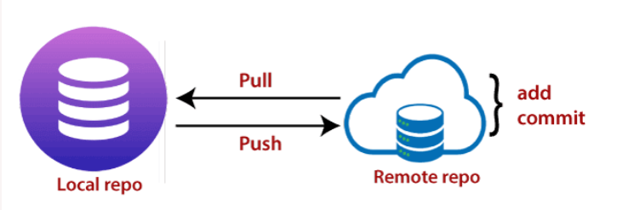
Git push
The push term refers to upload local repository content to a remote repository. Pushing is an act of transfer commits from your local repository to a remote repository. Pushing is capable of overwriting changes; caution should be taken when pushing.
Git push
Git push origin <branch name>

Slide 15
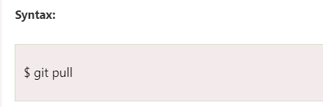
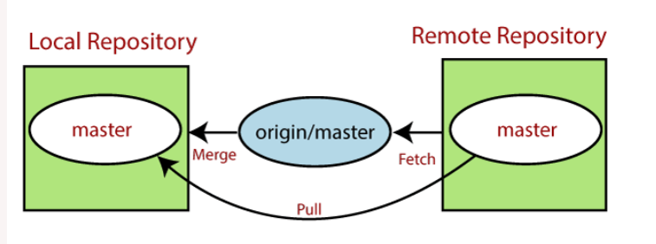
Git pull
The term pull is used to receive data from GitHub. It fetches and merges changes from the remote server to your working directory. The git pull command is used to pull a repository.

Slide 16
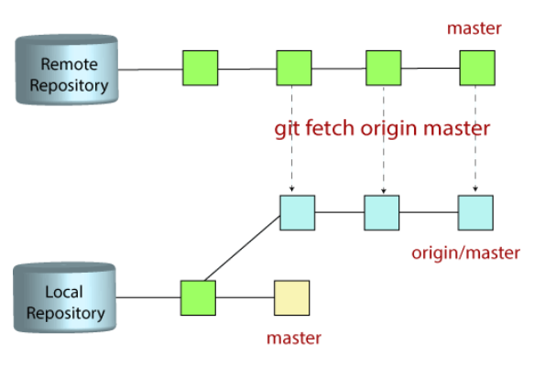
Git fetch
Git "fetch" Downloads commits, objects and refs from another repository. It fetches branches and tags from one or more repositories. It holds repositories along with the objects that are necessary to complete their histories to keep updated remote-tracking branches

Slide 17
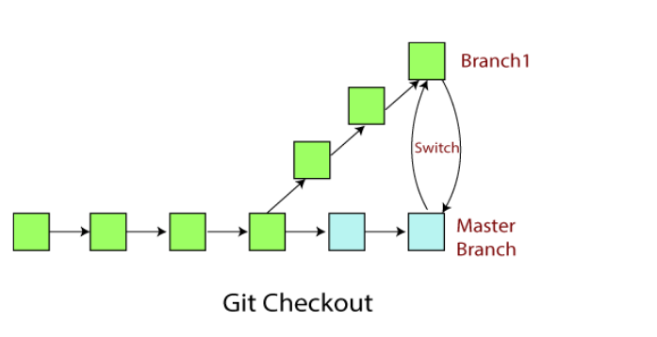
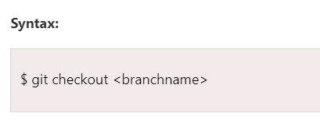
Git checkout
In Git, the term checkout is used for the act of switching between different versions of a target entity. The git checkout command is used to switch between branches in a repository. Be careful with your staged files and commits when switching between branches.

Slide 18
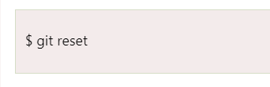
Git reset
The term reset stands for undoing changes. The git reset command is used to reset the changes. The git reset command has three core forms of invocation
You can jump up and forth between the various commits. Each of these reset variations affects specific trees that git uses to handle your file in its content.
Syntax

Slide 19

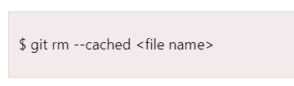
Git rm
In Git, the term rm stands for remove. It is used to remove individual files or a collection of files. The key function of git rm is to remove tracked files from the Git index. Additionally, it can be used to remove files from both the working directory and staging index.
The files being removed must be ideal for the branch to remove. No updates to their contents can be staged in the index. Otherwise, the removing process can be complex, and sometimes it will not happen. But it can be done forcefully by -f option.

